Slide 1


CSBridge
Control Flow
Control Flow Revisited
Stanford University, Ohlone College
CS Bridge 2021
June 30, 2021

Slide 2


Variable Analogy
num_students = 700
num_students
int
700
name
type
value

Slide 3
Teeny Tiny Suitcases
int
700
My computer has space for about 2 billion suitcases

Slide 4
Create, Modify, Use
# Create a variable, of type int
# called age with the value 31.
age = 31
# Modify age to be one greater.
age = age + 1
# Use the value in age (output it)
print(“age is: ” + age)

Slide 5
Create, Modify, Use
# Create a variable, of type int
# called age with the value 30.
age = 31
# Modify age to be one greater.
age = age + 1
# Use the value in age (output it)
print(“age is: ” + age)
int
age
31

Slide 6
Create, Modify, Use
# Create a variable, of type int
# called age with the value 31.
age = 31
# Modify age to be one greater.
age = age + 1
# Use the value in age (output it)
print(“age is: ” + age)
int
age
31

Slide 7
Create, Modify, Use
# Create a variable, of type int
# called age with the value 30.
age = 31
# Modify age to be one greater.
age = age + 1
# Use the value in age (output it)
print(“age is: ” + age)
32
int
age
31

Slide 8
Create, Modify, Use
# Create a variable, of type int
# called age with the value 30.
age = 31
# Modify age to be one greater.
age = age + 1
# Use the value in age (output it)
print(“age is: ” + age)
32
int
age
32

Slide 9
Create, Modify, Use
# Create a variable, of type int
# called age with the value 30.
age = 31
# Modify age to be one greater.
age = age + 1
# Use the value in age (output it)
print(“age is: ” + age)
int
age
32

Slide 10
Create, Modify, Use
# Create a variable, of type int
# called age with the value 30.
age = 31
# Modify age to be one greater.
age = age + 1
# Use the value in age (output it)
print(“age is: ” + str(age))
int
age
32

Slide 11
Binary Operators
+
Addition
*
Multiplication
–
Subtraction
/
Division
There are others too!
%
Remainder
//
Int Division
**
Exponentiation

Slide 12
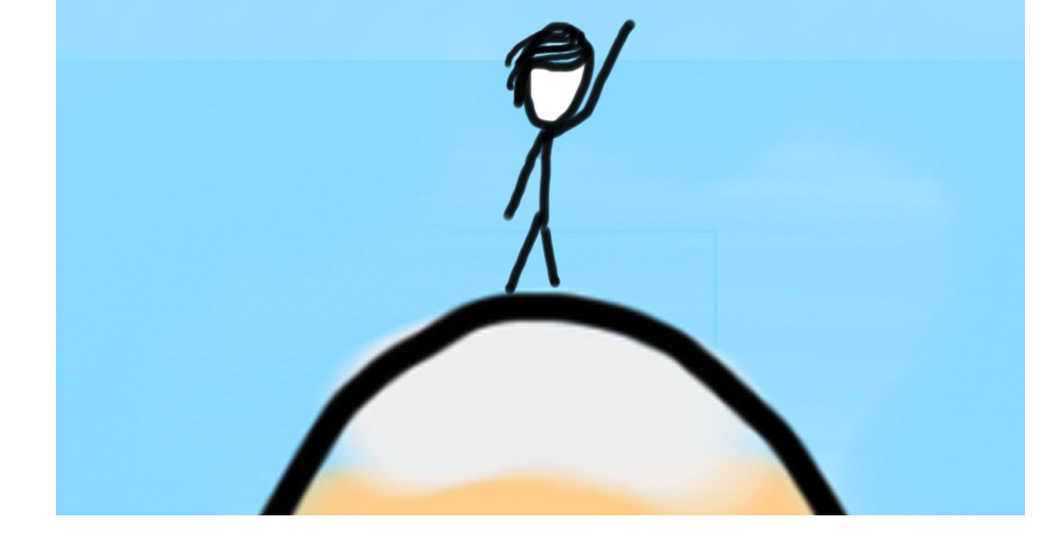

This Afternoon’s Goals
Be able to use while and if in Python
Combine loops and variables

Slide 13
while Loop in Karel
while front_is_clear() :
body
if beepers_present() :
body

Slide 14
while Loop Redux
while condition :
body
if condition :
body
The condition should be a “boolean” which is either True or False

Slide 15

Loops in Python
Use while and if statements in Python.
They are the same as in Karel, except that the test can be any expression that evaluates to True or False

Slide 16
Conditions?
Anything that resolves to a “True” or “False” answer is a condition
1 < 2

Slide 17
Conditions
Anything that resolves to a “True” or “False” answer is a condition
1 < 2
This is a comparison operator
True

Slide 18
Conditions
Anything that resolves to a “True” or “False” answer is a condition
my_var < 2
This is a comparison operator
True

Slide 19
First Example
while 1 < 2 :
print("programming is awesome!")
print("woot")

Slide 20
First Example
while 1 < 2 :
print("programming is awesome!")
print("woot")

Slide 21
First Example
while 1 < 2 :
print("programming is awesome!")
print("woot")

Slide 22
First Example
while 1 < 2 :
print("programming is awesome!")
print("woot")

Slide 23
First Example
while 1 < 2 :
print("programming is awesome!")
print("woot")

Slide 24
First Example
while 1 < 2 :
print("programming is awesome!")
print("woot")

Slide 25
First Example
while 1 < 2 :
print("programming is awesome!")
print("woot")

Slide 26
First Example
while 1 < 2 :
print("programming is awesome!")
print("woot")

Slide 27
Comparison Operators
Operator | Meaning | Example | Value
== | equals | 1 + 1 == 2 | True
!= | does not equal | 3.2 != 2.5 | True
< | less than | 10 < 5 | False
> | greater than | 10 > 5 | True
<= | less than or equal to | 126 <= 100 | False
>= | greater than or equal to | 5.0 >= 5.0 | True
* All have same precedence

Slide 28
Comparison Operators
Operator | Meaning | Example | Value
== | equals | 1 + 1 == 2 | True
!= | does not equal | 3.2 != 2.5 | True
< | less than | 10 < 5 | False
> | greater than | 10 > 5 | True
<= | less than or equal to | 126 <= 100 | False
>= | greater than or equal to | 5.0 >= 5.0 | True
* All have same precedence
Notes:
Equals is weird because single equals is assignment!

Slide 29
= vs ==
In Python:
==
Is a comparison operator
=
Is used for variable assignment

Slide 30
Comparison Operators
if 1 < 2 :
print("1 is less than 2")
num = int(input("Enter a number: "))
if num == 0: print("That number is 0")
else :
print("That number is not 0.")
This is a condition

Slide 31
If Else Revisited
num = int(input("Enter a number: "))
if num == 0:
print("Your number is 0 ")
else:
if num > 0:
print("Your number is positive")
else:
print("Your number is negative")
Notes:
No redundant conditions

Slide 32
If Else Revisited
num = int(input("Enter a number: "))
if num == 0:
print("Your number is 0 ")
elif num > 0:
print("Your number is positive")
else:
print("Your number is negative")
Notes:
No redundant conditions

Slide 33
if else Revisited
num = int(input("Enter a number: "))
if num == 0:
print("Your number is 0 ")
elif num > 0:
print("Your number is positive")
else:
print("Your number is negative")
Notes:
No redundant conditions

Slide 34
if else Revisited
“5”
num = int(input("Enter a number: "))
if num == 0:
print("Your number is 0 ")
elif num > 0:
print("Your number is positive")
else:
print("Your number is negative")
Enter a number:
5
Notes:
No redundant conditions

Slide 35
if else Revisited
5
num = int(input("Enter a number: "))
if num == 0:
print("Your number is 0 ")
elif num > 0:
print("Your number is positive")
else:
print("Your number is negative")
Enter a number:
5
Notes:
No redundant conditions

Slide 36
if else Revisited
5
num = int(input("Enter a number: "))
if num == 0:
print("Your number is 0 ")
elif num > 0:
print("Your number is positive")
else:
print("Your number is negative")
5
Enter a number:
5
num
Notes:
No redundant conditions

Slide 37
if else Revisited
num = int(input("Enter a number: "))
if num == 0:
print("Your number is 0 ")
elif num > 0:
print("Your number is positive")
else:
print("Your number is negative")
5
Enter a number:
5
num
Notes:
No redundant conditions

Slide 38
if else Revisited
num = int(input("Enter a number: "))
if num == 0:
print("Your number is 0 ")
elif num > 0:
print("Your number is positive")
else:
print("Your number is negative")
5
Enter a number:
5
num
Notes:
No redundant conditions

Slide 39
if else Revisited
num = int(input("Enter a number: "))
if num == 0:
print("Your number is 0 ")
elif num > 0:
print("Your number is positive")
else:
print("Your number is negative")
5
Enter a number:
5
Your number is positive
num
Notes:
No redundant conditions

Slide 40
if else Revisited
num = int(input("Enter a number: "))
if num == 0:
print("Your number is 0 ")
elif num > 0:
print("Your number is positive")
else:
print("Your number is negative")
5
Enter a number:
5
Your number is positive
num
Notes:
No redundant conditions

Slide 41
Let’s do it again!

Slide 42
if else Revisited
num = int(input("Enter a number: "))
if num == 0:
print("Your number is 0 ")
elif num > 0:
print("Your number is positive")
else:
print("Your number is negative")
Notes:
No redundant conditions

Slide 43
if else Revisited
“-2”
num = int(input("Enter a number: "))
if num == 0:
print("Your number is 0 ")
elif num > 0:
print("Your number is positive")
else:
print("Your number is negative")
Enter a number:
-2
Notes:
No redundant conditions

Slide 44
if else Revisited
-2
num = int(input("Enter a number: "))
if num == 0:
print("Your number is 0 ")
elif num > 0:
print("Your number is positive")
else:
print("Your number is negative")
Enter a number:
-2
Notes:
No redundant conditions

Slide 45
if else Revisited
-2
num = int(input("Enter a number: "))
if num == 0:
print("Your number is 0 ")
elif num > 0:
print("Your number is positive")
else:
print("Your number is negative")
-2
Enter a number:
-2
num
Notes:
No redundant conditions

Slide 46
if else Revisited
num = int(input("Enter a number: "))
if num == 0:
print("Your number is 0 ")
elif num > 0:
print("Your number is positive")
else:
print("Your number is negative")
-2
Enter a number:
-2
num
Notes:
No redundant conditions

Slide 47
if else Revisited
num = int(input("Enter a number: "))
if num == 0:
print("Your number is 0 ")
elif num > 0:
print("Your number is positive")
else:
print("Your number is negative")
-2
Enter a number:
-2
num
Notes:
No redundant conditions

Slide 48
if else Revisited
num = int(input("Enter a number: "))
if num == 0:
print("Your number is 0 ")
elif num > 0:
print("Your number is positive")
else:
print("Your number is negative")
-2
Enter a number:
-2
num
Notes:
No redundant conditions

Slide 49
if else Revisited
num = int(input("Enter a number: "))
if num == 0:
print("Your number is 0 ")
elif num > 0:
print("Your number is positive")
else:
print("Your number is negative")
-2
Enter a number:
-2
Your number is negative
num
Notes:
No redundant conditions

Slide 50
Amazing

Slide 51
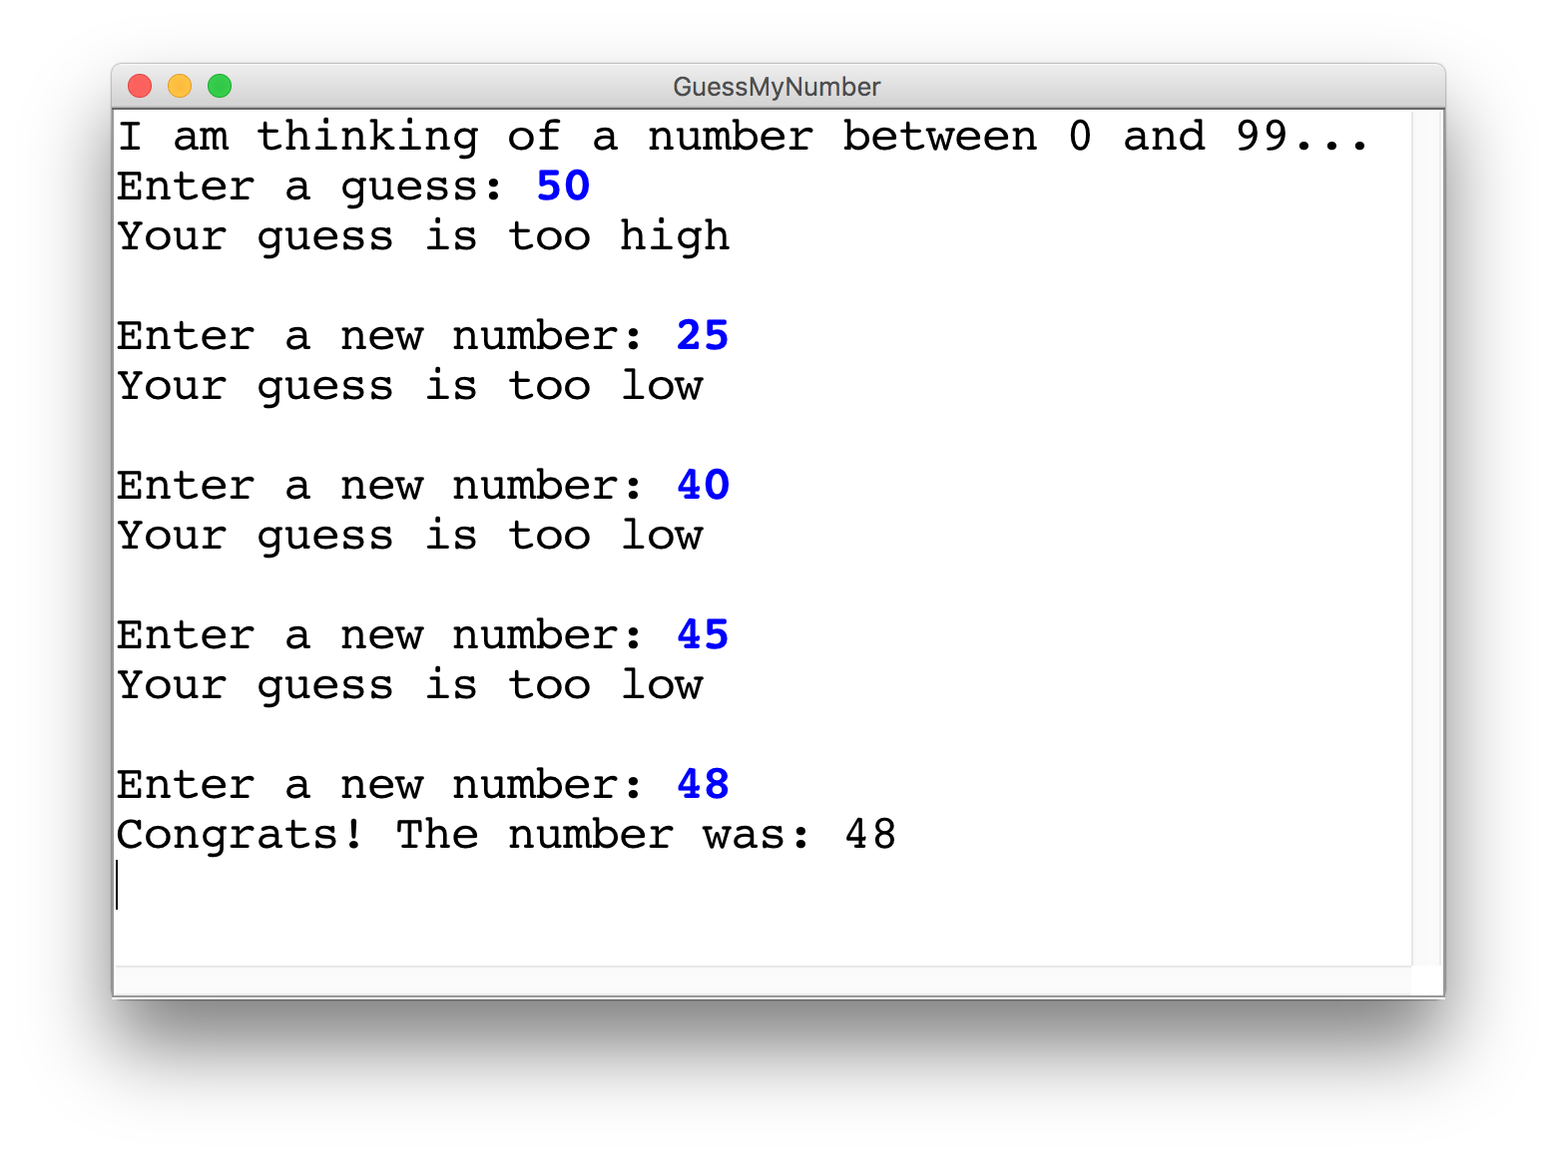
Guess My Number

Slide 52
Brace yourself!

Slide 53
Guess My Number
secret_number = random.randint(1, 99)
print("I am thinking of a number between 1 and 99...")
guess = int(input("Enter a guess: "))
# True if guess is not equal to secret number
while guess != secret_number:
# True if guess is less than secret number
if guess < secret_number:
print("Your guess is too low")
else:
print("Your guess is too high")
print("") # an empty line
guess = int(input("Enter a new guess: "))
print("Congrats! The number was: " + str(secret_number))
92
int
secret_number

Slide 54
Guess My Number
secret_number = random.randint(1, 99)
print("I am thinking of a number between 1 and 99...")
guess = int(input("Enter a guess: "))
# True if guess is not equal to secret number
while guess != secret_number:
# True if guess is less than secret number
if guess < secret_number:
print("Your guess is too low")
else:
print("Your guess is too high")
print("") # an empty line
guess = int(input("Enter a new guess: "))
print("Congrats! The number was: " + str(secret_number))
92
int
secret_number

Slide 55
Guess My Number
secret_number = random.randint(1, 99)
print("I am thinking of a number between 1 and 99...")
guess = int(input("Enter a guess: "))
# True if guess is not equal to secret number
while guess != secret_number:
# True if guess is less than secret number
if guess < secret_number:
print("Your guess is too low")
else:
print("Your guess is too high")
print("") # an empty line
guess = int(input("Enter a new guess: "))
print("Congrats! The number was: " + str(secret_number))
50
int
92
int
guess
secret_number

Slide 56
Guess My Number
secret_number = random.randint(1, 99)
print("I am thinking of a number between 1 and 99...")
guess = int(input("Enter a guess: "))
# True if guess is not equal to secret number
while guess != secret_number:
# True if guess is less than secret number
if guess < secret_number:
print("Your guess is too low")
else:
print("Your guess is too high")
print("") # an empty line
guess = int(input("Enter a new guess: "))
print("Congrats! The number was: " + str(secret_number))
50
int
92
int
guess
secret_number

Slide 57
Guess My Number
secret_number = random.randint(1, 99)
print("I am thinking of a number between 1 and 99...")
guess = int(input("Enter a guess: "))
# True if guess is not equal to secret number
while guess != secret_number:
# True if guess is less than secret number
if guess < secret_number:
print("Your guess is too low")
else:
print("Your guess is too high")
print("") # an empty line
guess = int(input("Enter a new guess: "))
print("Congrats! The number was: " + str(secret_number))
50
int
92
int
guess
secret_number

Slide 58
Guess My Number
secret_number = random.randint(1, 99)
print("I am thinking of a number between 1 and 99...")
guess = int(input("Enter a guess: "))
# True if guess is not equal to secret number
while guess != secret_number:
# True if guess is less than secret number
if guess < secret_number:
print("Your guess is too low")
else:
print("Your guess is too high")
print("") # an empty line
guess = int(input("Enter a new guess: "))
print("Congrats! The number was: " + str(secret_number))
50
int
92
int
guess
secret_number

Slide 59
Guess My Number
secret_number = random.randint(1, 99)
print("I am thinking of a number between 1 and 99...")
guess = int(input("Enter a guess: "))
# True if guess is not equal to secret number
while guess != secret_number:
# True if guess is less than secret number
if guess < secret_number:
print("Your guess is too low")
else:
print("Your guess is too high")
print("") # an empty line
guess = int(input("Enter a new guess: "))
print("Congrats! The number was: " + str(secret_number))
50
int
92
int
guess
secret_number

Slide 60
Guess My Number
secret_number = random.randint(1, 99)
print("I am thinking of a number between 1 and 99...")
guess = int(input("Enter a guess: "))
# True if guess is not equal to secret number
while guess != secret_number:
# True if guess is less than secret number
if guess < secret_number:
print("Your guess is too low")
else:
print("Your guess is too high")
print("") # an empty line
guess = int(input("Enter a new guess: "))
print("Congrats! The number was: " + str(secret_number))
95
int
92
int
guess
secret_number

Slide 61
Guess My Number
secret_number = random.randint(1, 99)
print("I am thinking of a number between 1 and 99...")
guess = int(input("Enter a guess: "))
# True if guess is not equal to secret number
while guess != secret_number:
# True if guess is less than secret number
if guess < secret_number:
print("Your guess is too low")
else:
print("Your guess is too high")
print("") # an empty line
guess = int(input("Enter a new guess: "))
print("Congrats! The number was: " + str(secret_number))
95
int
92
int
guess
secret_number

Slide 62
Guess My Number
secret_number = random.randint(1, 99)
print("I am thinking of a number between 1 and 99...")
guess = int(input("Enter a guess: "))
# True if guess is not equal to secret number
while guess != secret_number:
# True if guess is less than secret number
if guess < secret_number:
print("Your guess is too low")
else:
print("Your guess is too high")
print("") # an empty line
guess = int(input("Enter a new guess: "))
print("Congrats! The number was: " + str(secret_number))
95
int
92
int
guess
secret_number

Slide 63
Guess My Number
secret_number = random.randint(1, 99)
print("I am thinking of a number between 1 and 99...")
guess = int(input("Enter a guess: "))
# True if guess is not equal to secret number
while guess != secret_number:
# True if guess is less than secret number
if guess < secret_number:
print("Your guess is too low")
else:
print("Your guess is too high")
print("") # an empty line
guess = int(input("Enter a new guess: "))
print("Congrats! The number was: " + str(secret_number))
95
int
92
int
guess
secret_number

Slide 64
Guess My Number
secret_number = random.randint(1, 99)
print("I am thinking of a number between 1 and 99...")
guess = int(input("Enter a guess: "))
# True if guess is not equal to secret number
while guess != secret_number:
# True if guess is less than secret number
if guess < secret_number:
print("Your guess is too low")
else:
print("Your guess is too high")
print("") # an empty line
guess = int(input("Enter a new guess: "))
print("Congrats! The number was: " + str(secret_number))
95
int
92
int
guess
secret_number

Slide 65
Guess My Number
secret_number = random.randint(1, 99)
print("I am thinking of a number between 1 and 99...")
guess = int(input("Enter a guess: "))
# True if guess is not equal to secret number
while guess != secret_number:
# True if guess is less than secret number
if guess < secret_number:
print("Your guess is too low")
else:
print("Your guess is too high")
print("") # an empty line
guess = int(input("Enter a new guess: "))
print("Congrats! The number was: " + str(secret_number))
95
int
92
int
guess
secret_number

Slide 66
Guess My Number
secret_number = random.randint(1, 99)
print("I am thinking of a number between 1 and 99...")
guess = int(input("Enter a guess: "))
# True if guess is not equal to secret number
while guess != secret_number:
# True if guess is less than secret number
if guess < secret_number:
print("Your guess is too low")
else:
print("Your guess is too high")
print("") # an empty line
guess = int(input("Enter a new guess: "))
print("Congrats! The number was: " + str(secret_number))
92
int
92
int
guess
secret_number

Slide 67
Guess My Number
secret_number = random.randint(1, 99)
print("I am thinking of a number between 1 and 99...")
guess = int(input("Enter a guess: "))
# True if guess is not equal to secret number
while guess != secret_number:
# True if guess is less than secret number
if guess < secret_number:
print("Your guess is too low")
else:
print("Your guess is too high")
print("") # an empty line
guess = int(input("Enter a new guess: "))
print("Congrats! The number was: " + str(secret_number))
92
int
92
int
guess
secret_number

Slide 68
Guess My Number
secret_number = random.randint(1, 99)
print("I am thinking of a number between 1 and 99...")
guess = int(input("Enter a guess: "))
# True if guess is not equal to secret number
while guess != secret_number:
# True if guess is less than secret number
if guess < secret_number:
print("Your guess is too low")
else:
print("Your guess is too high")
print("") # an empty line
guess = int(input("Enter a new guess: "))
print("Congrats! The number was: " + str(secret_number))
92
int
92
int
guess
secret_number

Slide 69
Guess My Number
secret_number = random.randint(1, 99)
print("I am thinking of a number between 1 and 99...")
guess = int(input("Enter a guess: "))
# True if guess is not equal to secret number
while guess != secret_number:
# True if guess is less than secret number
if guess < secret_number:
print("Your guess is too low")
else:
print("Your guess is too high")
print("") # an empty line
guess = int(input("Enter a new guess: "))
print("Congrats! The number was: " + str(secret_number))
92
int
92
int
guess
secret_number

Slide 70
Conditions in Python
Think about what variables you want to declare before the loop starts!

Slide 71
Guess My Number
secret_number = random.randint(1, 99)
print("I am thinking of a number between 1 and 99...")
guess = int(input("Enter a guess: "))
# True if guess is not equal to secret number
while guess != secret_number:
# True if guess is less than secret number
if guess < secret_number:
print("Your guess is too low")
else:
print("Your guess is too high")
print("") # an empty line
guess = int(input("Enter a new guess: "))
print("Congrats! The number was: " + str(secret_number))
92
int
92
int
guess
secret_number

Slide 72
Guess My Number
secret_number = random.randint(1, 99)
print("I am thinking of a number between 1 and 99...")
guess = int(input("Enter a guess: "))
# True if guess is not equal to secret number
while guess != secret_number:
# True if guess is less than secret number
if guess < secret_number:
print("Your guess is too low")
else:
print("Your guess is too high")
print("") # an empty line
guess = int(input("Enter a new guess: "))
print("Congrats! The number was: " + str(secret_number))
92
int
92
int
guess
secret_number

Slide 73
Random Integers
Minimum value
secret_number = random.randint(1, 99)
Maximum value

Slide 74
Challenge: Three Sixes in a row
Write a program that simulates one dice roll at a time. Count how many dice rolls until you get three sixes in a row!
You rolled a 6
You rolled a 6
You rolled a 3
You rolled a 2
You rolled a 1
You rolled a 4
You rolled a 6
You rolled a 6
You rolled a 6
Number of times rolled = 152
Notes:
11:45AM
Think pair share (hint: fencepost)

Slide 75
Example: Sentinel Loops
# fencepost problem!
# ask for number - post
# add number to total - fence
def main():
num_dice_rolls = 0
# repeat these lines
dice_value = random.randint(1, 6)
num_dice_rolls += 1
print(num_dice_rolls)

Slide 76
Example: Sentinel Loops
def main(): num_dice_rolls = 0 sixes_in_a_row = 0 while sixes_in_a_row < GOAL_IN_A_ROW: dice_value = random.randint(1,6) print('You rolled a ' + str(dice_value)) if dice_value == GOAL_VALUE: sixes_in_a_row += 1 else: sixes_in_a_row = 0 num_dice_rolls += 1 print(num_dice_rolls)

Slide 77
Example: Sentinel Loops
def main(): num_dice_rolls = 0 sixes_in_a_row = 0 while sixes_in_a_row < GOAL_IN_A_ROW: dice_value = random.randint(1,6) print('You rolled a ' + str(dice_value)) if dice_value == GOAL_VALUE: sixes_in_a_row += 1 else: sixes_in_a_row = 0 num_dice_rolls += 1 print(num_dice_rolls)
0
int
0
int
num_dice_rolls
sixes_in_a_row

Slide 78
Example: Sentinel Loops
def main(): num_dice_rolls = 0 sixes_in_a_row = 0 while sixes_in_a_row < GOAL_IN_A_ROW: dice_value = random.randint(1,6) print('You rolled a ' + str(dice_value)) if dice_value == GOAL_VALUE: sixes_in_a_row += 1 else: sixes_in_a_row = 0 num_dice_rolls += 1 print(num_dice_rolls)
0
int
0
int
num_dice_rolls
sixes_in_a_row

Slide 79
Example: Sentinel Loops
def main(): num_dice_rolls = 0 sixes_in_a_row = 0 while sixes_in_a_row < GOAL_IN_A_ROW: dice_value = random.randint(1,6) print('You rolled a ' + str(dice_value)) if dice_value == GOAL_VALUE: sixes_in_a_row += 1 else: sixes_in_a_row = 0 num_dice_rolls += 1 print(num_dice_rolls)
0
int
0
int
6
int
num_dice_rolls
sixes_in_a_row
dice_value

Slide 80
Example: Sentinel Loops
def main(): num_dice_rolls = 0 sixes_in_a_row = 0 while sixes_in_a_row < GOAL_IN_A_ROW: dice_value = random.randint(1,6) print('You rolled a ' + str(dice_value)) if dice_value == GOAL_VALUE: sixes_in_a_row += 1 else: sixes_in_a_row = 0 num_dice_rolls += 1 print(num_dice_rolls)
0
int
0
int
6
int
num_dice_rolls
sixes_in_a_row
dice_value

Slide 81
Example: Sentinel Loops
def main(): num_dice_rolls = 0 sixes_in_a_row = 0 while sixes_in_a_row < GOAL_IN_A_ROW: dice_value = random.randint(1,6) print('You rolled a ' + str(dice_value)) if dice_value == GOAL_VALUE: sixes_in_a_row += 1 else: sixes_in_a_row = 0 num_dice_rolls += 1 print(num_dice_rolls)
0
int
0
int
6
int
num_dice_rolls
sixes_in_a_row
dice_value

Slide 82
Example: Sentinel Loops
def main(): num_dice_rolls = 0 sixes_in_a_row = 0 while sixes_in_a_row < GOAL_IN_A_ROW: dice_value = random.randint(1,6) print('You rolled a ' + str(dice_value)) if dice_value == GOAL_VALUE: sixes_in_a_row += 1 else: sixes_in_a_row = 0 num_dice_rolls += 1 print(num_dice_rolls)
0
int
1
int
6
int
num_dice_rolls
sixes_in_a_row
dice_value

Slide 83
Example: Sentinel Loops
def main(): num_dice_rolls = 0 sixes_in_a_row = 0 while sixes_in_a_row < GOAL_IN_A_ROW: dice_value = random.randint(1,6) print('You rolled a ' + str(dice_value)) if dice_value == GOAL_VALUE: sixes_in_a_row += 1 else: sixes_in_a_row = 0 num_dice_rolls += 1 print(num_dice_rolls)
1
int
1
int
6
int
num_dice_rolls
sixes_in_a_row
dice_value

Slide 84
Example: Sentinel Loops
def main(): num_dice_rolls = 0 sixes_in_a_row = 0 while sixes_in_a_row < GOAL_IN_A_ROW: dice_value = random.randint(1,6) print('You rolled a ' + str(dice_value)) if dice_value == GOAL_VALUE: sixes_in_a_row += 1 else: sixes_in_a_row = 0 num_dice_rolls += 1 print(num_dice_rolls)
1
int
1
int
num_dice_rolls
sixes_in_a_row

Slide 85
Example: Sentinel Loops
def main(): num_dice_rolls = 0 sixes_in_a_row = 0 while sixes_in_a_row < GOAL_IN_A_ROW: dice_value = random.randint(1,6) print('You rolled a ' + str(dice_value)) if dice_value == GOAL_VALUE: sixes_in_a_row += 1 else: sixes_in_a_row = 0 num_dice_rolls += 1 print(num_dice_rolls)
1
int
1
int
4
int
num_dice_rolls
sixes_in_a_row
dice_value

Slide 86
Example: Sentinel Loops
def main(): num_dice_rolls = 0 sixes_in_a_row = 0 while sixes_in_a_row < GOAL_IN_A_ROW: dice_value = random.randint(1,6) print('You rolled a ' + str(dice_value)) if dice_value == GOAL_VALUE: sixes_in_a_row += 1 else: sixes_in_a_row = 0 num_dice_rolls += 1 print(num_dice_rolls)
1
int
1
int
4
int
num_dice_rolls
sixes_in_a_row
dice_value

Slide 87
Example: Sentinel Loops
def main(): num_dice_rolls = 0 sixes_in_a_row = 0 while sixes_in_a_row < GOAL_IN_A_ROW: dice_value = random.randint(1,6) print('You rolled a ' + str(dice_value)) if dice_value == GOAL_VALUE: sixes_in_a_row += 1 else: sixes_in_a_row = 0 num_dice_rolls += 1 print(num_dice_rolls)
1
int
1
int
4
int
num_dice_rolls
sixes_in_a_row
dice_value

Slide 88
Example: Sentinel Loops
def main(): num_dice_rolls = 0 sixes_in_a_row = 0 while sixes_in_a_row < GOAL_IN_A_ROW: dice_value = random.randint(1,6) print('You rolled a ' + str(dice_value)) if dice_value == GOAL_VALUE: sixes_in_a_row += 1 else: sixes_in_a_row = 0 num_dice_rolls += 1 print(num_dice_rolls)
1
int
1
int
4
int
num_dice_rolls
sixes_in_a_row
dice_value

Slide 89
Example: Sentinel Loops
def main(): num_dice_rolls = 0 sixes_in_a_row = 0 while sixes_in_a_row < GOAL_IN_A_ROW: dice_value = random.randint(1,6) print('You rolled a ' + str(dice_value)) if dice_value == GOAL_VALUE: sixes_in_a_row += 1 else: sixes_in_a_row = 0 num_dice_rolls += 1 print(num_dice_rolls)
1
int
0
int
4
int
num_dice_rolls
sixes_in_a_row
dice_value

Slide 90
Example: Sentinel Loops
def main(): num_dice_rolls = 0 sixes_in_a_row = 0 while sixes_in_a_row < GOAL_IN_A_ROW: dice_value = random.randint(1,6) print('You rolled a ' + str(dice_value)) if dice_value == GOAL_VALUE: sixes_in_a_row += 1 else: sixes_in_a_row = 0 num_dice_rolls += 1 print(num_dice_rolls)
2
int
0
int
4
int
num_dice_rolls
sixes_in_a_row
dice_value

Slide 91
Example: Sentinel Loops
def main(): num_dice_rolls = 0 sixes_in_a_row = 0 while sixes_in_a_row < GOAL_IN_A_ROW: dice_value = random.randint(1,6) print('You rolled a ' + str(dice_value)) if dice_value == GOAL_VALUE: sixes_in_a_row += 1 else: sixes_in_a_row = 0 num_dice_rolls += 1 print(num_dice_rolls)
1
int
0
int
4
int
num_dice_rolls
sixes_in_a_row
dice_value

Slide 92
When will it get to this line?
def main(): num_dice_rolls = 0 sixes_in_a_row = 0 while sixes_in_a_row < GOAL_IN_A_ROW: dice_value = random.randint(1,6) print('You rolled a ' + str(dice_value)) if dice_value == GOAL_VALUE: sixes_in_a_row += 1 else: sixes_in_a_row = 0 num_dice_rolls += 1 print(num_dice_rolls)
?
int
?
int
?
int
num_dice_rolls
sixes_in_a_row
dice_value

Slide 93
Logical Operators
In order of precedence:
Operator | Example | Result
not | not (2 == 3) | True
and | (2 == 3) and (-1 < 5) | False
or | (2 == 3) or (-1 < 5) | True
num1 = int(input("Enter a positive number: "))
num2 = int(input("Enter another pos number: "))
if num1 < 0 or num2 < 0:
print("invalid input")

Slide 94
George Boole
English Mathematician teaching in Ireland 1815 – 1864
Notes:
Sam the eagle

Slide 95
Boolean Variables
# Store expressions that evaluate to True/False
x = 1 < 2 # True
y = 5.0 == 4.0 # False
boolean
x
True
y
boolean
False

Slide 96
Boolean Variables
# Store expressions that evaluate to True/False
x = 1 < 2 # True
y = 5.0 == 4.0 # False
# Directly set to True/False
is_teaching = True
is_rock_climbing = False

Slide 97
Boolean Variables
# Store expressions that evaluate to True/False
# Case Sensitive: True/False, cannot be true/false
x = 1 < 2 # True
y = 5.0 == 4.0 # False
# Directly set to True/False
is_teaching = True
is_rock_climbing = False
play_again = input(’Play again? "y” or "n”’) == ‘y’
if play_again:
...

Slide 98
This is hard! Learn a little each day.

Slide 99
This Afternoon’s Goals
Be able to use while and if in Python
Combine loops and variables

